Slide 1
Reproducibility of
Graph Neural Networks in Multiview Brain Connectivity
Hızır Can Bayram
Advisor: Prof. Dr. Mustafa Serdar Çelebi
Co-Advisor: Dr. Islem Rekik
06.02.2024

Slide 2
Contents
1. Network Neuroscience | Brain scales, neuroimaging and brain connectivity
2. Introduction | Network neuroscience, its major problems and our aim in this thesis
3. Mathematical Model | Theory behind neural networks used in our thesis
4. Literature Review | Previous methods and critique of state of the art method
5. Quantifying Reproducibility | Problem statement and our proposed method
6. Numerical Experiments | Datasets used and experiments designed in our thesis
7. Discussion | Findings of our experiments
8. Conclusion | Final remarks
2

Slide 3
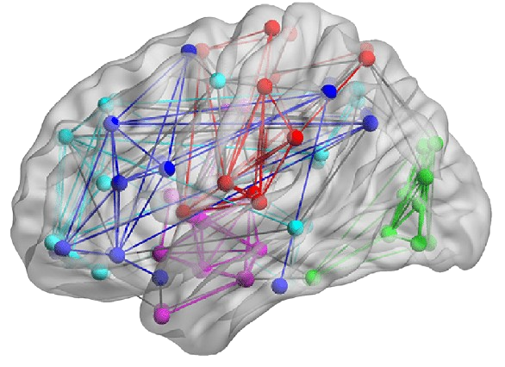
Network Neuroscience
- Exploring brain functions is top scientific priorities - We use brain networks to explore
such functions
brain structure
mental processes
diagnosis & treatment of disorders
decision making processes
- All of these are carried out under network neuroscience
3
Notes:
Understanding the brain is vital because it helps us comprehend human thoughts and actions, paving the way for progress in health and neuroscience. To do so we use brain networks.
Brain networks are a conceptual model that represents interconnected neural pathways in the brain. They reveal how different brain regions communicate, and providing insights the roots of neurological disorders.
All of these are carried out under network neuroscience. Network neuroscience is a field that studies the brain as a complex network of interconnected elements, such as neurons or brain regions.

Slide 4
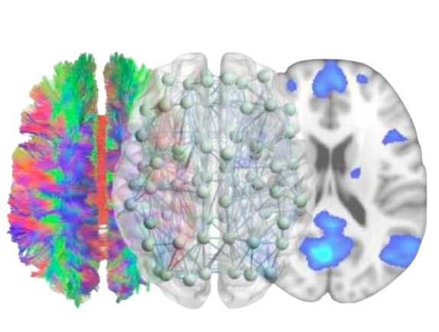
Brain Connectivity
- Brain connectivity is the connections by distinct units, such as neurons, a group of neurons or regions, within the nervous system
- Each representation of the connections in the brain
by different structural characteristics is called view, in a multigraph data set
Structural connectivity
Functional connectivity
Mahro, A. (2019) [2]
4
Notes:
The ways that different parts of the brain communication and interconnected brain regions are called brain connectivity. That is what we used to create such networks. These ways can be either physical connections or information exchange.
If it is a physical connection between brain regions we call it structural connectivity, whereas if it is a pattern of neural activity that occurs simultaneously in different areas we call it functional connectivity.
We will call these connections in the brain by different structural characteristics as views, in a multigraph data set.

Slide 5
Network Neuroscience
- Network neuroscience studies the brain analyzing how brain regions are connected structurally and functionally
Network Neuroscience
Neuroscience
Graph theory
Neuroimaging
Analyzing
5
Notes:
Network neuroscience field consists of various subareas such as neuroscience, neuroimaging, model analyzing and graph theory.
In terms of our thesis highlights, we will touch upon neuroimaging and model analyzing.

Slide 6
Network Neuroscience
- Network neuroscience studies the brain analyzing how brain regions are connected structurally and functionally
Network Neuroscience
Neuroscience
Graph theory
Neuroimaging
Analyzing
6
Notes:
Let’s summarize neuroimaging first.

Slide 7
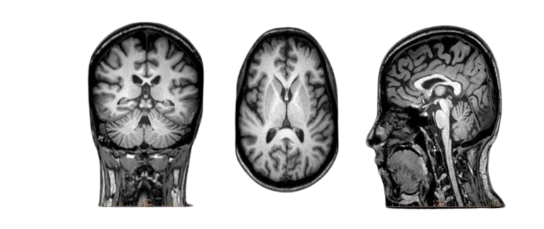
Neuroimaging
Neuroimaging encompasses imaging techniques for structural and functional visualization of the brain
Functional neuroimaging
Structural neuroimaging
- T1-weighted magnetic resonance imaging
Acer et al. (2011) [3]
7
Notes:
Neuroimaging is a field that involves various techniques for visualizing and examining the structure and function of the brain. We categorizies neuroimaging techniques as functional and structural neuroimaging.
We obtain structural connections using structural imaging whereas functional connections are captured bu functional imaging techniques. The dataset that are used in our thesis is created from T1-weighted magnetic resonance imaging, a structural neuroimaging technique.
We can summarize T1-weighted magnetic resonance imaging as a neuroimaging technique that emphasizes the contrast in the tissues based on their T1 relaxation times.

Slide 8
Network Neuroscience
- Network neuroscience studies the brain analyzing how brain regions are connected structurally and functionally
Network Neuroscience
Neuroscience
Graph theory
Neuroimaging
Analyzing
8
Notes:
Let’s move on to the model analyzing.

Slide 9
Analyzing
- There are manual and machine learning-based techniques for analyzing brain networks
- Leveraging neural networks, has made deciphering complex patterns in brain networks more accessible
- Graph neural networks have been the s.o.t.a. methods to solve and analyze network neuroscience problems
9
Notes:
We can categorize analyze methods for brain networks as manual and machine-learning based. The first uses graph theory concepts heavily and require a lot of feature engineering manually whereas machine learning-based techniques are in more automatic manner.
Brain has intrinsicly complex structure, leading machine-learning based techniques to be used more frequently. Leveraging neural networks, particularly for their automatic feature extraction and large-scale data processing capability, has made deciphering complex patterns in brain networks more accessible.
Lately, graph neural networks, a subarea of neural networks, have been the s.o.t.a. methods to solve network neuroscience problem.

Slide 10
Brain Network Problems
- We can categorize network neuroscience problems that are solved using graph neural networks as
The integration of brain graphs
The prediction of brain graph
The classification of brain graph
10
Notes:
We can categorize network neuroscience problems that are solved using graph neural networks as
The integration of brain graphs
The prediction of brain graph
The classification of brain graph
We will take a look at each of the problem definitions briefly.

Slide 11
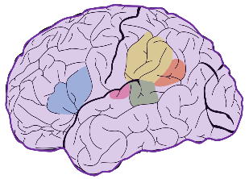
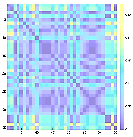
The Integration of Brain Graphs
Creating a unified and meaningful representation of a brain population
Subject 1
…
…
Graph 1
Subject M
Graph M
Training Set
11
Notes:
This problem deals with creating a unified and meaningful representation of a brain population. We have brain networks from different patients that belong to a specific brain state such as autism, normal control etc.
We use these samples to generate a unified and meaningful representation of a brain population that contains common and shared characteristics of the brain state. To do so, we first turn our brain data into graph format, an adjacency matrix.

Slide 12
The Integration of Brain Graphs
…
+
…
+
…
Subject 1
…
…
…
Graph 1
Subject M
Graph M
Deep Learning Model
Training Set
12
Notes:
We then train a GNN model with our training set. We can think of the model as an encoder-decoder architecture that takes all these different samples and generate the shared characteristics of a brain state.

Slide 13
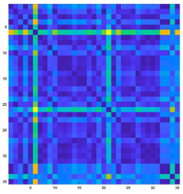
The Integration of Brain Graphs
…
+
…
+
…
Subject 1
…
…
…
Graph 1
Subject M
Graph M
Deep Learning Model
Final CBT
Training Set
13
Notes:
We create a CBT, a mapped adjacency matrix of the same size, that is unified and meaningful representation of the brain state.

Slide 14
The Integration of Brain Graphs
Backpropagation
…
+
…
+
…
Subject 1
…
…
…
Graph 1
Subject M
Graph M
Deep Learning Model
Final CBT
Training Set
Loss Function
GNN minimizes the difference between its CBT with a validation set in an unsupervised manner
Subject 1
…
…
Graph 1
Subject M
Graph M
Training Set
14
Notes:
To optimize this CBT, we use our validation set and employ a loss function that minimizes the difference between the generated CBT and each sample in the validation set using a distance function in an unsupervised manner.
Based on this difference, backpropagation mechanism of the model comes into play and updates the weights of the model so that it can generate better unified and generated CBT.

Slide 15
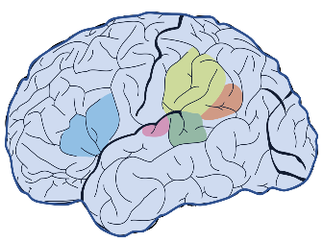
The Prediction of Brain Graphs
Graph 1
…
…
+
…
+
…
…
…
Graph M
GAN-Based Model
Training Phase
Synthesizing brain graphs from specific samples in a dataset
15
Notes:
This problem deals with synthesizing brain graphs from specific samples in a dataset. Medical imaging is expensive and inaccessible. Thus, one of the biggest obstacle to achieving good results is the inadequacy of the dataset.
This will help solving problems such as overfitting that may occur due to small data, as well as contributing to have generalizable models by creating large datasets that cover the sample space better.

Slide 16
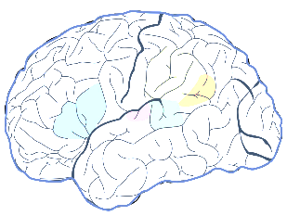
The Prediction of Brain Graphs
Graph 1
…
…
+
…
+
…
…
…
Graph M
GAN-Based Model
Training Phase
Graph 1
…
…
+
…
+
…
…
…
Graph M
Cross-domain Graph Prediction
GAN-Based Model
Testing Phase
Notes:
The primary goal is to predict a target brain graph based on a single source graph. To do so generative-based GNNs are employed.
Other than synthesizing graphs based on single source graphs, generating high-resolution brain graphs and predicting the state of a brain graph at time t have been proposed in the literature.

Slide 17
The Prediction of Brain Graphs
Graph 1
+
…
…
…
…
…
Graph M
Training Data
Classifier Model
Classifying brain graphs based on their states
Identifying discriminative features for a specific state
17
Notes:
The last problem we mentioned is the brain graph classification problem. This is an important problem for early disease diagnosis, especially diseases such as Alzheimer, autism spectrum disorder etc.
There are two main problems here. One is to classify brain graphs according to whether they are healthy or not. The second is to determine the discriminative features in unhealthy brain graphs. This can provide insights into the origin of the existing disease.

Slide 18
The Prediction of Brain Graphs
Graph 1
+
…
…
…
…
…
Graph M
Training Data
Classifier Model
Discriminated Data
Aiming to maximize their success metrics
Missing how their results are generalizable and reproducible
18
Notes:
However, all of these problems share a prime challenge: They only aim to maximize their success metrics such as distance score, accuracy, f1-score etc. They miss how their results are generalizable and reproducible in a different data distribution; what biomarkers might cause a disease.
Questions such as if the model is based on a noise learned during training, or if it relies on a feature related to the solved task are essential considerations. These factors are as critical as optimizing the targeted metric because determining whether the obtained score truly represents the entire problem and data space is a significant challenge.

Slide 19
Mathematical Model
Graph : A data structure that consists of nodes and edges
Graph Neural Networks (GNNs) : Neural Networks designed to process graph-structured data
Three fundamental components of GNNs:
Node embeddings
Message passing
Aggregation functions
Node Embeddings
The primary goal of GNNs : Learning embeddings for each node in a graph
Embeddings : High dimensional vectors
19
Notes:
What are these Graph Neural Networks?
Graph : A data structure that consists of nodes and edges which help flow the information
Graph Neural Networks (GNNs) : Neural Networks designed to process graph-structured data. It captures semantic relationship between nodes
Three fundamental components of GNNs: Node embeddings Message passing Aggregation functions
Node Embeddings: The primary goal of GNNs is to learn embeddings for each node in a graph, which capture both its local and global structural information

Slide 20
Mathematical Model
Message Passing & Aggregation Functions
Fundamental operation in GNNs
Nodes and their adjacent nodes interact to collect data about their nearby surroundings
Based on their neigbors in each level, nodes refine their representations
We can express this as
Aggregation is to use for aggregate the information coming from the neighbors
Model parameters are updated in backward phase
Message Passing & Aggregation Functions
Each layer employes message-passing mechanism
The embeddings obtained at the final layer can serve different purposes : node/edge/graph classification
20
Notes:
4. h is the embedding of node v at layer l, N(v) is the set of neighbors, AGGR is to combine
Aggregation is to use for aggregate the information coming from the neighbors
5. Averaging, maxima or garph convolution
Model parameters are updated in backward phase
6. Based on local and global information in different neighbors
Message Passing & Aggregation Functions
Each layer employes message-passing mechanism
2.1 Every node updates its embeddings by incorporating information from local and global nodes
The embeddings obtained at the final layer can serve different purposes
2.2 Depending on the design of the last layer in the architecture

Slide 21
Mathematical Model
GNNs employed in this thesis are the same as in RG-Select
GNN Architectures
DiffPool
Uses Differential pooling to generate a learned hierarchical represetation of the input
GAT*
Uses masked self-attentional layers to classify nodes
GCN*
Uses graph convolution layers
SAGPool
Uses graph pooling method based on self-attention
Graph-U-Net
An encode-decoder model is employed for graph classification
21
Notes:
The GNNs with stars are added a global mean pooling layer to each node in order to use them for graph classification

Slide 22
Thesis Objective
We focus on assessing the reproducibility scores of GNN models
Models are trained with multigraph data from T1-w MRI images
They are employed to classify if a given multigraph is with autism
We propose a method, RepNet, that assigns a reproducibility score to each GNN
22
Notes:
The primary objective of this thesis is to examine graph neural networks with a particular emphasis on reproducibility. We chose the graph classification problem from the three fundamental problems mentioned above.
Models are trained with multigraph data from T1-w MRI images. They are employed to classify if a given multigraph is with autism. We conducted all the designs and experiments for our reproducibility method on graph classification problem.
We propose a method, RepNet, that assigns a reproducibility score to each GNN. This work, with some minor tuning, can be extended into other problems as well.

Slide 23
Thesis Objective
We aim to find answers to these research questions
What assumptions should a superior method rely on?
Are the reproducibility scores correlated with their capability?
How do GNN architectures rank and what are the highlighted keys?
Are the top biomarkers from the best model clinically meaningful?
23

Slide 24
Literature Review
- Related Work
Cross-validation
Divides data, trains on subsets
Bootstrapping
Randomly samples data, trains multiple times
Primitive clue about reproducibility
It is indirect
Neither a reproducibility score nor it is correlated with a model’s reproducibility capability
24
Notes:
These methods give us some clue about reproducibility capability of a model
They evaluate reproducibility over the result metrics in an indirect manner
They don’t generate a reproducibility score correlated with a model’s reproducibility capability

Slide 25
Literature Review
- Related Work
Identifying the best data-driven feature selection method for boosting reproducibility in classification tasks
Applying various feature selection (FS) methods to individually trained SVM classifiers
Defining reproducibility as the shared biomarkers across different FS methods
Building an adjacency matrix made up of N nodes from a collection of N FS methods
The final FS-to-FS matrix was created by averaging similarity matrices of the three built graphs
Finally, summing the matrix along any axis to obtain reproducibility scores of FS methods – node strength
25
Notes:
For a brain state classification problem, they apply various feature selection (FS) methods to the SVM classifiers that are trained individually.
They define reproducibility as the shared biomarkers across different FS methods.
They built a graph (an adjacency matrix) made up of N nodes from a collection of N FS methods.
Where each node represented an FS method.
And each edge linking two nodes records their relationship by a certain feature.
Reproducibility similarity between two FS methods.
Accuracy similarity across between FS methods.
Stability similarity across between FS methods.
The final FS-to-FS matrix S was created by averaging similarity matrices of the three built graphs.

Slide 26
Literature Review
- Related Work
Identifying the best data-driven feature selection method for boosting reproducibility in classification tasks
It works with multigraph data
It identifies most discriminative biomarkers
It finds the most reproducible FS method
It extracts features in a manual way, not suitable for GNNs
The classification procedure is not end-to-end
Leading even the most reproducible FS method cannot obtain competitive results
26
Notes:
When we look at this method’s ups and downs;
GENISLETIP OKUMAYA BASLA

Slide 27
Literature Review
- Related Work
Investigating and Quantifying the Reproducibility of Graph Neural Networks in Predictive Medicine
Proposing a graph-topology-based framework to select the most reproducible GNN for a classification task
Assuming that diverse GNNs will identify overlapping top biomarkers
Building an adjacency matrix made up of N nodes from a collection of N GNN architectures
All matrices with different hyperparameters are averaged within one view –only, of the brain connectivity
27
Notes:
For a brain state classification problem, they proposed a graph-topology-based framework to select the most reproducible GNN.
They assume that diverse GNNs will identify overlapping top biomarkers because they try to learn by the same problem.
They built a graph (an adjacency matrix) made up of N nodes from a collection of N GNN architectures.
Where each node represented a GNN architecture.
And each edge linking two nodes records the ratio of shared biomarkers and total biomarkers.
All matrices with different hyperparameters are averaged within each view of the brain connectivity.

Slide 28
Literature Review
- Related Work
Investigating and Quantifying the Reproducibility of Graph Neural Networks in Predictive Medicine
The most reproducible GNN model is chosen using the node strength attribute
It works with multigraph data
It identifies most discriminative biomarkers
It finds the most reproducible GNN model
It extracs features automatically, thanks to GNN
The method only focuses on the inter-model reproducibility score of GNNs
It does not consider inter-view reproducibility score
28
Notes:
When we look at this method’s ups and downs;
GENISLETIP OKUMAYA BASLA

Slide 29
Literature Review
- Related Work
Quantifying the Reproducibility of Graph Neural Networks using Multigraph Data Representation
It is called RG-Select, in short.
They proposed a graph-topology-based framework to select the most reproducible GNN
Assuming that a model identifies overlapping biomarkers across different GNN architectures and views
They built two graphs (adjacency matrices) made up of N nodes from a collection of N GNN architectures
The view-specific matrix
The GNN-specific matrix
29
Notes:
For a brain state classification problem, they proposed a graph-topology-based framework to select the most reproducible GNN using inter-model and inter-view reproducibility.
They assume that a model will identify overlapping top biomarkers across different GNN architectures and different views that it is trained on.
They built two graphs (adjacency matrices) made up of N nodes from a collection of N GNN architectures.
Where each node represented a GNN architecture.
And each edge linking two nodes records the ratio of shared biomarkers by total biomarkers.
The view-specific matrix : Examining similarities between biomarkers of different GNNs.
The GNN-specific matrix : Assessing similarities between biomarkers of GNNs trained with different views.

Slide 30
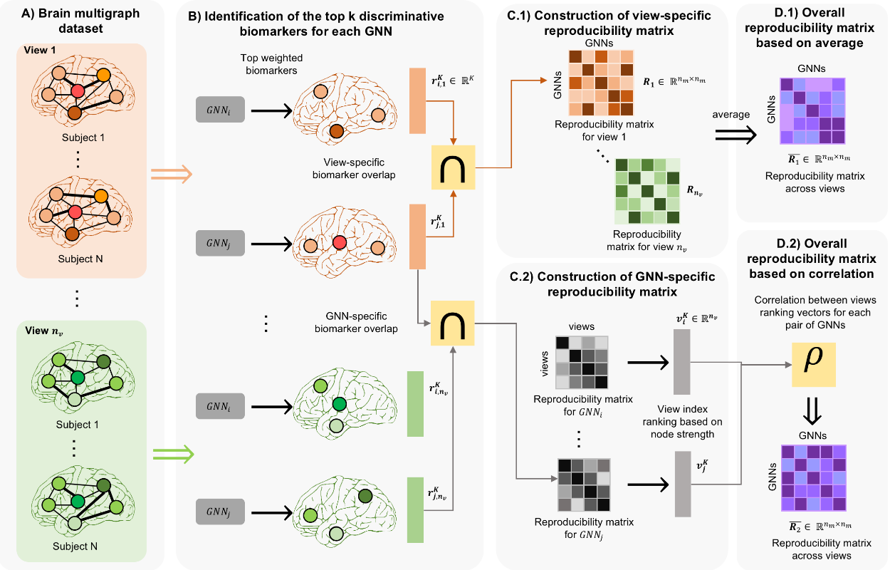
Literature Review
- Related Work
22
Notes:
Number of biomarkers’ın farklı threshold’larca uygulandıgından bahset mutlaka. Critique kısmında buna atıf olacak.
They built two graphs (adjacency matrices) made up of N nodes from a collection of N GNN architectures.
Where each node represented a GNN architecture.
And each edge linking two nodes records the ratio of shared biomarkers by total biomarkers.
The view-specific matrix : Examining similarities between biomarkers of different GNNs.
The GNN-specific matrix : Assessing similarities between biomarkers of GNNs trained with different views.
SLAYT UZERINDEN ANLAT

Slide 31
Literature Review
- Related Work
Quantifying the Reproducibility of Graph Neural Networks using Multigraph Data Representation
These matrices were combined element-wise to form a final matrix
This matrix and the node strength property were employed to measure a GNN model’s reproducibility
It works with multigraph data
It identifies most discriminative biomarkers
It finds the most reproducible GNN model
It extracs features automatically, thanks to GNN
It considers both : inter-model and inter-view reproducibility
It is the state-of-the-art-method in the literature
However...
31

Slide 32
Literature Review
- Critique of the State-of-the-art Method
We critique the state-of-the-art method in three key areas:
Definitions and hypotheses
Methodology
Experiments
Definitions and hypotheses
Reproducibility of a model depends on the intersection of the model’s biomarkers
Models with low reproducibility skewing the scores of highly reproducible models
The inability to independently measure reproducibility
32
Notes:
Reproducibility of a model depends on the intersection of the model’s biomarkers with the biomarkers identified by other GNN models.
This may affect the reproducibility score, especially when models with low reproducibility are involved, potentially skewing the scores of highly reproducible models.
The inability to independently calculate a score based solely on a model's capability is highlighted, as the score is influenced by the reproducibility of other models.

Slide 33
Literature Review
- Critique of the State-of-the-art Method
Methodological problems
The limited number of thresholds
Averaging different matrices
33
Notes:
The limited number of thresholds raise concerns about the reliability of the reproducibility score. Say we determined threshold value of 10. If a biomarker is in the top 10 biomarkers, we add one to the nominator. Here, it does not matter if a biomarker is in the 5th place or 9th place. They make equal contribution to the reproducibility process, which is wrong.
Additionally, averaging different matrices for different threshold values, views, and training types results in information loss, especially for a situation where the numerical values of the biomarkers are close to each other, this averaging process can significantly change the order of importance.
SKIP. IQR deneyini yaparken biomarkerlarin onem siralari alinip IQR’lari hesaplandi. En reproducible model secildikten sonra o modelin top biomarkerlari elde edilirken farkli training setup’lardaki biomarkerlarin element-wise L2 normu alindi. Bu ikisini birbirine karistirma!

Slide 34
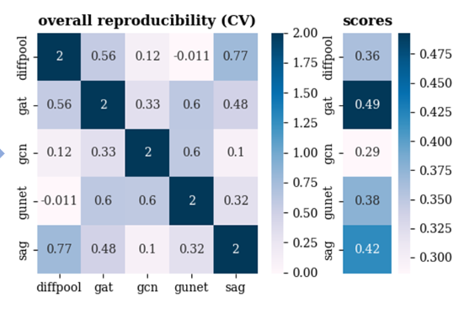
Literature Review
- Critique of the State-of-the-art Method
Experimental issues
The method's robustness is questioned, as the majority voting result of different metrics
and the method's metric are not consistently compatible for all models
Method | v.a. | r.c | a.w.i | a.w.c | s.c | a.r.i | KL | L2 | # of the 1st reproducible model | # of the 2nd reproducible model
2. DiffPool | 0.361 | 0 | 0.341 | 0.37 | 0.151 | 0.198 | 6.93 | 5.788 | 2 | 3
1. GAT | 0.355 | 0.138 | 0.281 | 0.624 | 0.2 | 0.208 | 15.025 | 9.07 | 4 | 0
3. GCN | 0.372 | -0.086 | 0.337 | 0.356 | -0.078 | 0.153 | 6.513 | 5.777 | 2 | 2
4. g-U-Nets | 0.373 | 0.005 | 0.294 | 0.342 | -0.036 | 0.132 | 8.931 | 6.694 | 1 | 0
5. SAGPool | 0.362 | 0.057 | 0.303 | 0.562 | 0.045 | 0.177 | 7.726 | 6.666 | 0 | 2
Reproducibility scores for ASD/NC RH in RG-Select for external validation.
v.a: views average. r.c: rank correlation. a.w.i: accumulated weighted intersection. a.w.c: accumulated weights correlation.
s.c: strength correlation. a.r.: accumulated rank intersection. KL: KL divergence. L2: L2 distance
Reproducibility scores for ASD/NC RH in RG-Select.
Notes:
The method's robustness is questioned, as the majority voting result of different metrics and the method's metric are not consistently compatible for all models.
As an external validation, they employed different metrics other than view-specific and GNN-specific metrics and claim that the majority voting of these metrics gives the most reproducible model. Though it is correct, this majority voting does not work for the rest of the models.
MODEL SIRALAMA FARKLILIKLARINI GORSEL UZERINDEN ANLAT

Slide 35
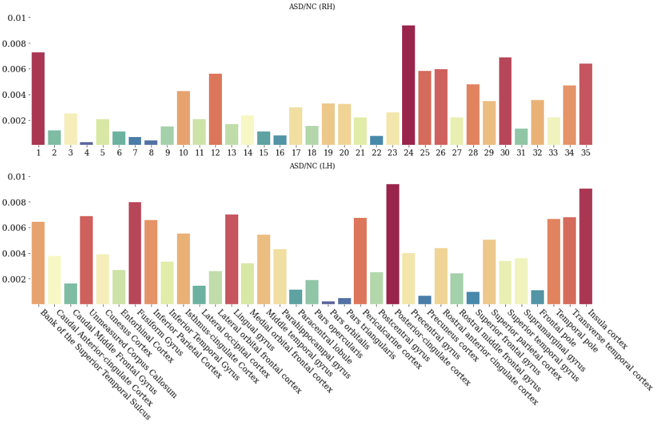
Literature Review
- Critique of the State-of-the-art Method
Experimental issues
The averaging biomarkers to select top biomarkers
Notes:
To obtain the top biomarkers, they average all weights from different training setups in an element-wise manner. This averaging process can significantly alter biomarker importance, the scores of biomarker importance are quite close to each other.
We will solve all three kind of problems in our method RepNet.
SKIP. IQR deneyini yaparken biomarkerlarin onem siralari alinip IQR’lari hesaplandi. En reproducible model secildikten sonra o modelin top biomarkerlari elde edilirken farkli training setup’lardaki biomarkerlarin element-wise L2 normu alindi. Bu ikisini birbirine karistirma!

Slide 36
Quantifying Reproducibility
- Problem Statement
We represent the dataset as
The set of brain connectivity multigraphs is denoted as
Their corresponding neurological state labels are denoted as
Each is described with an adjacency tensor and a binary label
We construct datasets for each view
The goal is to assess and rank a set of GNN models
We will rank them based on their reproducibility capability
36
Notes:
These are brain multigraphs generated from T1-w MRI images and are modelled as adjacency matrices. Each slot of this matrix corresponds to a segmented brain region of one specific brain connectivity characteristic.
We had defined what a view is previously.
We will have a variety of different GNN architectures and RepNet will assign a reproducibility score for each one and rank them.
SLAYTI OKU

Slide 37
Quantifying Reproducibility
- Problem Statement
Assessing and ranking a set of GNN models,
Reproducibility capability: GNN models having the same weights under different configs
Taking account of reproducing the last layer in order to
Simplifying the problem and comparing with previous work
Reproducing the last layer will tune the other layers to some extent
The objective of the models we will assess for reproducibility is to classify two different brain states
After training the models for classification, we measure their reproducibility using their weights
We will measure inter-view and inter-model reproducibility, as in RG-Select for a fair comparison
37
Notes:
The goal is to assess and rank a set of GNN models based on their reproducibility capability.
We define reproducibility capability as GNN models having the same weights under different training setups and data distributions.
In this thesis, we take account of reproducing the last layer in order to.
Simplify the problem and compare with previous work.
We assume that reproducing the last layer will tune the other layers to some extent.
The objective of the models we will assess for reproducibility is to classify two different brain states.
After training the models for classification, we measure their reproducibility using their weights.
We will measure inter-view and inter-model reproducibility, as in RG-Select for a fair comparison.

Slide 38
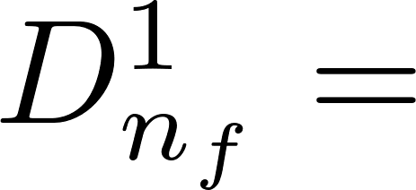
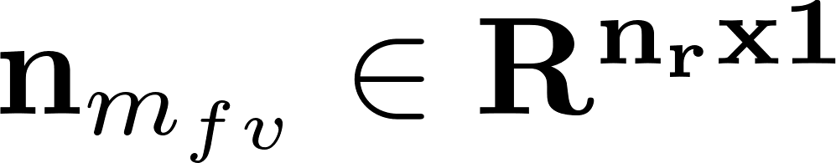
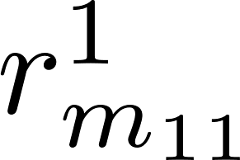
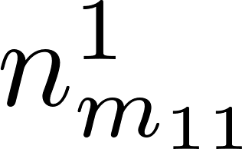
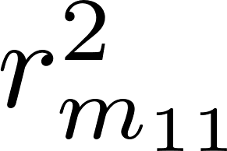
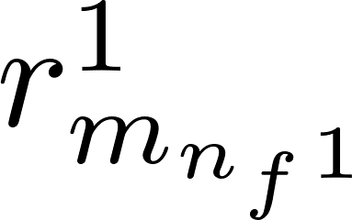
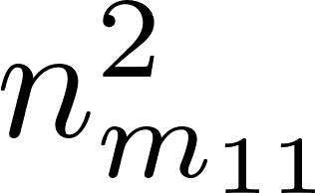
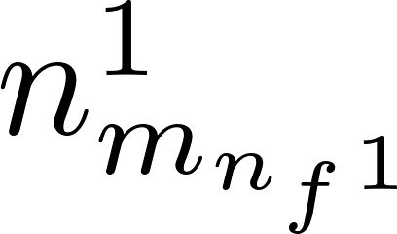
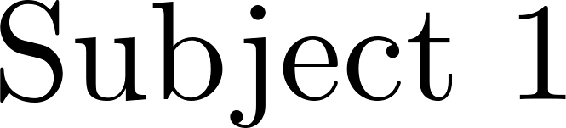
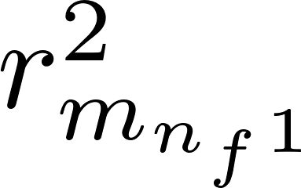
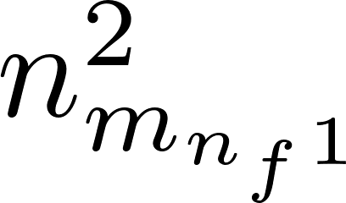
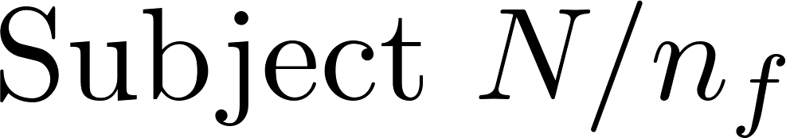
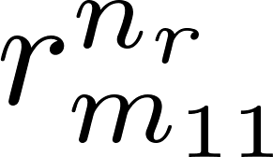
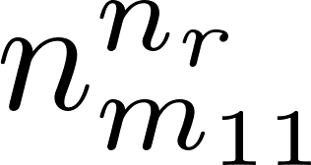

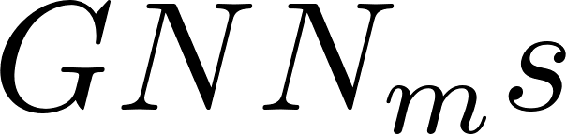
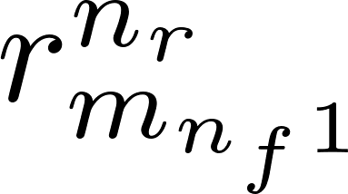
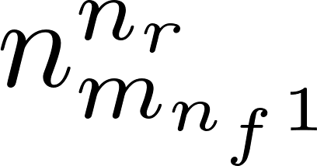
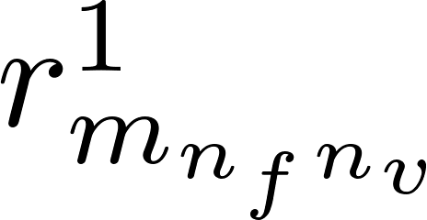
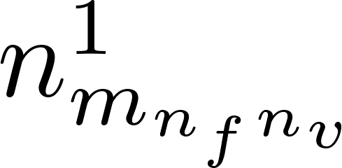
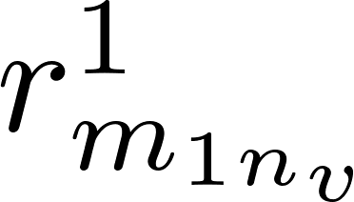
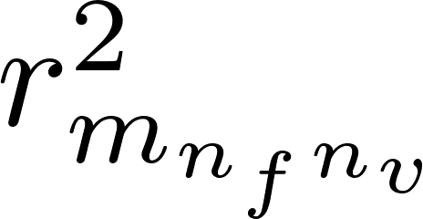
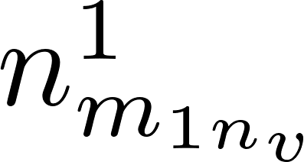
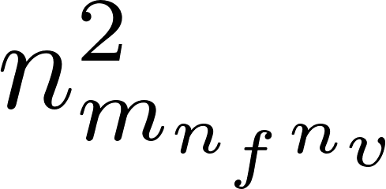
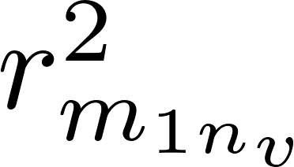
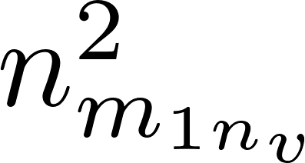
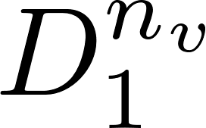
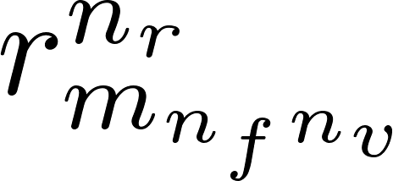
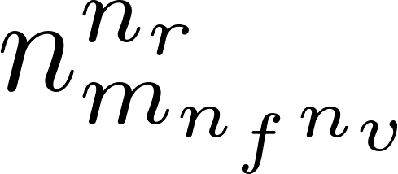
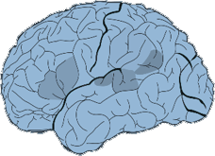
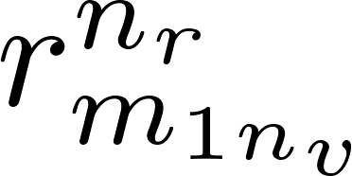
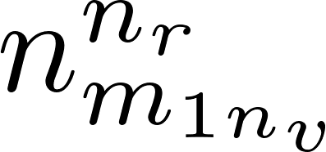
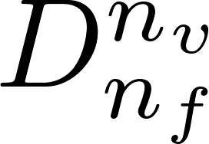
Quantifying Reproducibility
Training GNN on datasets composed of different views
B) Normalizing extracted feature vectors
- Inter-view Reproducibility Score
Let represent the biomarker vector of
We define such that
Following that, we determine the min and max values
We then define a new vector
This new vector contains the values related to the impact of each biomarker on the outcome
…
…
…
…
…
…
…
…
…
…
…
…
…
…
…
…
+
…
…
…
…
+
…
…
…
…
…
…
…
Deep Architecture
Fully Connected Layers
…
…
Fully Connected Layers
…
Deep Architecture
…
Abs
σ = 1
0
Operations
Abs
σ = 1
0
Takes element-wise absolute value of a vector
38
Normalizes each vector using min and max value of all vectors
Notes:
ŞEKİL ÜZERİNDEN DE ANLATIM YAP
1. r_m_fv is the last layer before the final layer
2. We need absolute value because we care about the magnitude, how much they contribute, of a biomarker
3-4. We then take the min and max value in all different datasets so that we can normalize each vector
5.In this way, we can know how big each biomarker in different configs contributes to a decision making process

Slide 39
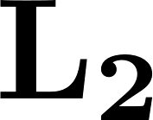

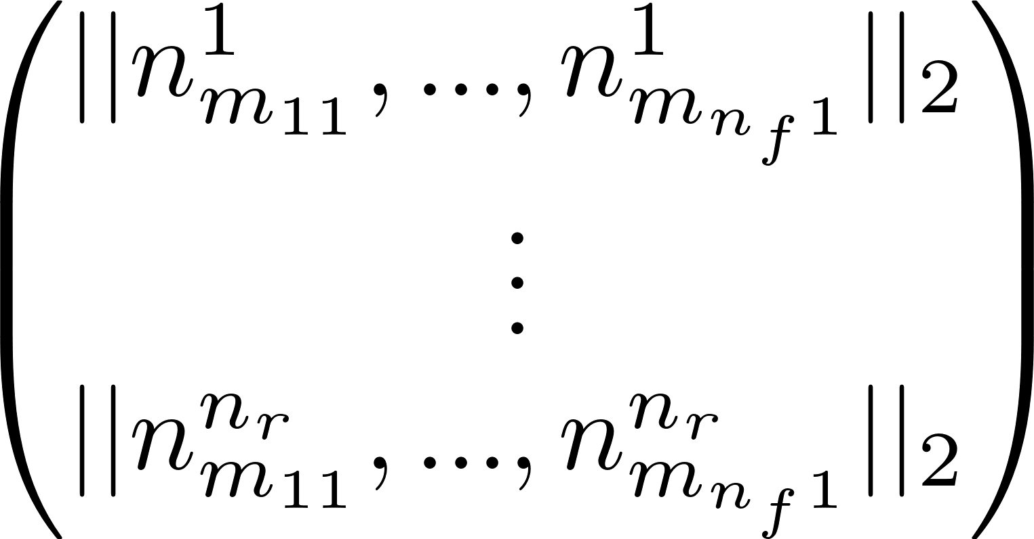

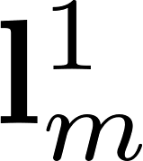
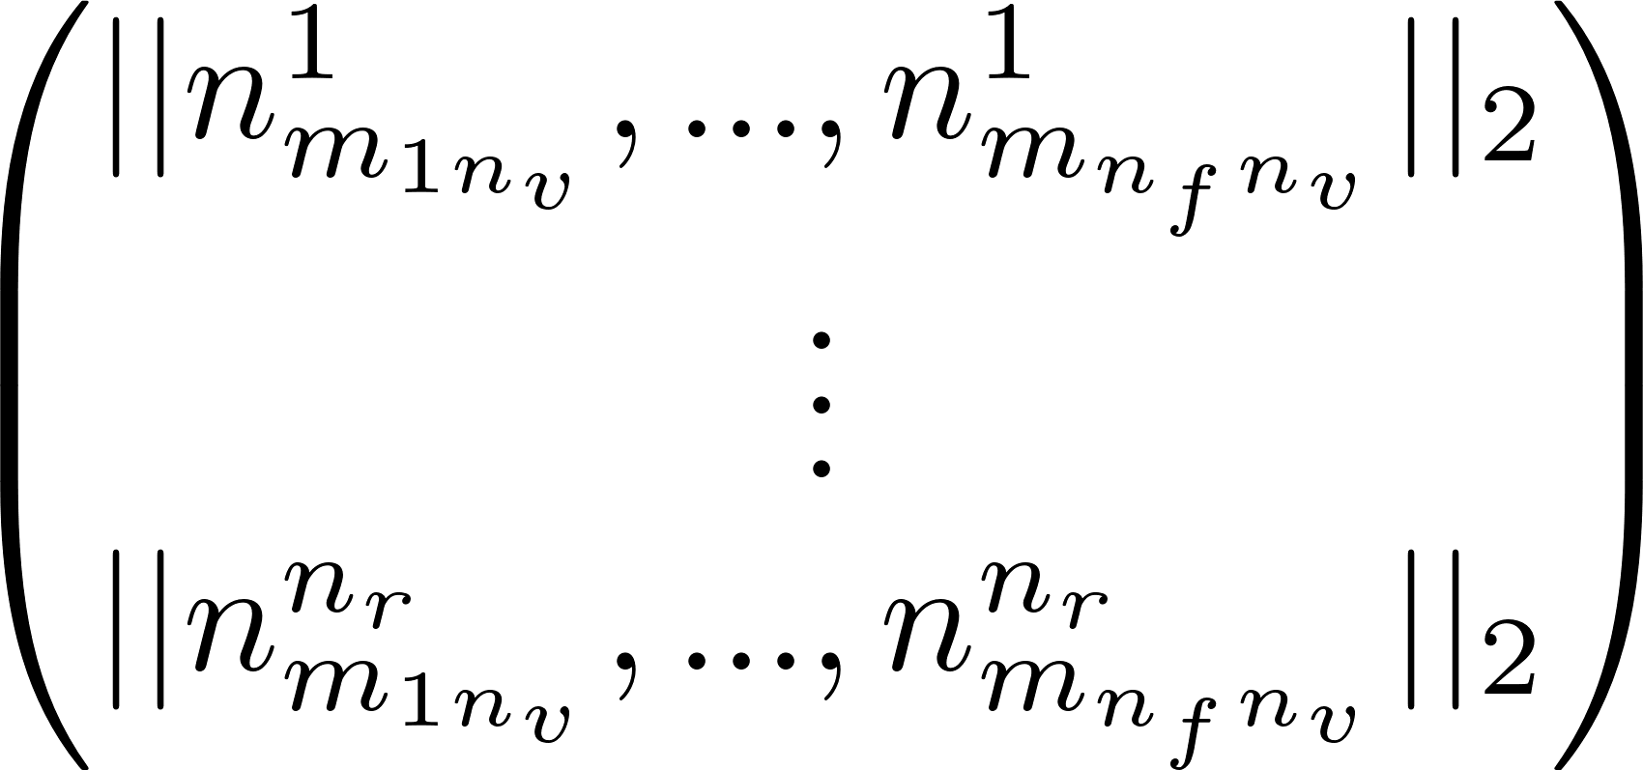

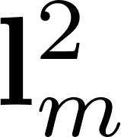
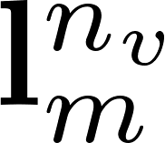
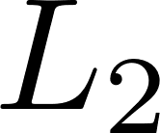
Quantifying Reproducibility
To assess the significance of individual biomarkers
We insert all biomarkers into a matrix
To asses the contribution of individual biomarkers, we establish row-based function
such that
B) Normalizing extracted feature vectors
…
…
…
…
…
…
…
…
…
…
…
C) Calculating norm of each feature across all vectors
…
…
…
…
…
Abs
Concat
X
σ = 1
0
Abs
σ = 1
0
Concat X
Operations
Takes element-wise absolute value of a vector
Normalizes each vector using min and max value of all vectors
Computes L2 norm of each feature across vectors
39
Concatenate vectors along X-axis
Notes:
OKU – and we obtained a vector «L to the power of v sub m»
ŞEKİL ÜZERİNDEN DE ANLATIM YAP

Slide 40



Quantifying Reproducibility
We then introduce by selecting the
top biomarkers from vector
We also introduce which signifies the indices of these top biomarkers
Indices correspond to biomarker names
We’ll use this for inter-model scores
We establish a distance vector
such that
This distance vector is a measure of how far the biomarkers obtained from different datasets are from complete reproducibility
The distance of this vector from 0 gives us the score
B) Normalizing extracted feature vectors
D) Constructing distance vector and computing reproducibility score
…
…
…
…
…
…
…
…
C(n,2)
…
…
…
C) Calculating norm of each feature across all vectors
…
…
…
…
…
Abs
Concat
X
σ = 1
0
Abs
σ = 1
0
Concat X
Operations
Takes element-wise absolute value of a vector
Normalizes each vector using min and max value of all vectors
Computes L2 norm of each feature across vectors
40
Concatenate vectors along X-axis
Notes:
OKU
ŞEKİL ÜZERİNDEN DE ANLATIM YAP

Slide 41
Quantifying Reproducibility
Training GNN on datasets composed of different views
B) Normalizing extracted feature vectors
D) Constructing distance vector and computing reproducibility score
…
…
…
…
…
…
…
…
…
…
C(n,2)
…
…
…
…
…
…
+
…
…
…
C) Calculating norm of each feature across all vectors
…
+
…
…
…
…
…
…
…
Deep Architecture
Fully Connected Layers
…
…
Fully Connected Layers
…
Deep Architecture
…
…
Abs
Concat
X
σ = 1
0
Operations
Abs
σ = 1
0
Concat X
C(n,2)
Takes element-wise absolute value of a vector
Normalizes each vector using min and max value of all vectors
Concatenate vectors along X-axis
Computes L2 norm of each feature across vectors
Combines top r vectors with each other
Notes:
SUMMARIZE SEKIL UZERINDEN

Slide 42
Quantifying Reproducibility
- Inter-model Reproducibility Score
We had introduced by selecting the top biomarkers from vector
We now introduce which signifies the indices of these top biomarkers
based on the magnitude values of the vector
For each the index vectors are averaged element-wise to form
Subsequently, a GNN-to-GNN matrix is constructued,
where represents the number of top biomarkers
shared between and , divided by for normalization
Summing this matrix along any axis yields a list of inter-model reproducibility scores
providing the reproducibility score for each GNN
42
Notes:
(3) For each...li cümleye dair: In this way we have an average biomarker importance indice for each biomarker. (4 view var zaten, onların ortalaması alınıyor)

Slide 43
Numerical Experiments
We will compare RepNet and RG-Select, state-of-the-art method
We first give detail about datasets and their partition for experiments
Internal inter-view reproducibility experiment
Inter-model reproducibility experiment
External validation to compare RepNet and RG-Select
Another measurement other than these methods
43
Notes:
We will compare RepNet and RG-Select, state-of-the-art method
We first give detail about datasets and their partition for experiments
We then cover inter-view reproducibility scores internally: Are the GNN rankings consistent across different training settings?
Next, we touch upon inter-model reproducibility scores
We, finally, introduce an external validation to compare two methods
Using a basic and interpretable method other than these methods: Even if we show that RepNet is consistent across different hyperparameters, we need to compare it with RG-Select using a common method.
Are the biomarker rankings across datasets and views consistent?

Slide 44
Numerical Experiments
- Dataset
The dataset is derived from the Autism Brain Imaging Data Exchange ABIDE I
150 patients with Autism Spectrum Disorder (ASD)
150 normal control patients (NC)
Structural T1-w MRI scans processed to generate cortical morphological networks
The left and right cerebral hemispheres were (LH and RH) divided into 35 cortical ROIs
Six cortical measures (views) are utilized to create multigraphsfor RH and LH brain
Maximum principal curvature
Cortical thickness
Sulcal depth
Average curvature
Cortical surface area
Minimum principal area
44
Notes:
3. These 35 cortical ROIs are n_v, cortical measures are n_v

Slide 45

Numerical Experiments
- Inter-view Reproducibility Scores
A higher score in RG-Select : better reproducibility capability
A lower score in Repnet : better reproducibility capability
Comparing two methods based on how they ranked GNN models
Superior method : maintain a consistent ranking of GNNs
This experiment measures the methods’ internal consistency
The table above corresponds to GNNs trained on the left hemisphere dataset, while the table below pertains to those trained on the right hemisphere.
45
Notes:
A higher score in RG-Select implies better reproducibility capability
A lower score in Repnet implies better reproducibility capability
Since it is the distance from complete reproducibility
We compared two methods based on how they ranked GNN models
Since these two methods measure reproducibility in different ways. One checks for higher whereas the other does for lower. Based on their intrinsic characteristics, we ranked them in descending order based on their reproducibility capability
Superior method should maintain a consistent ranking of GNNs
Regardless of different hemispheres or hyperparameters
This experiment measures the methods’ internal consistency

Slide 46

Numerical Experiments
46
Notes:
The GNN models were ranked based on their reproducibility scores
RepNet demonstrated a more stable and uniform ranking of GNNs compared to RG-Select
The successful internal validation of RepNet has been demonstrated through this experiment

Slide 47

Numerical Experiments
- Inter-model Reproducibility Scores
Inter-view and inter-model are calculated using seperate methods in RepNet
RG-Select used the same method for both types of scores
Scores are mapped between 0 and 1 in RepNet
No specific range in RG-Net
The higher value : better reproducibility capability in RepNet
The table above corresponds to GNNs trained on the left hemisphere dataset, while the table below pertains to those trained on the right hemisphere.
47
Notes:
We had explained that in RepNet Inter-view and inter-model are calculated using seperate methods
RG-Select, on the other hand, used the same method for both types of scores resulting in the generation of identical values for both score types
We mapped scores between 0 and 1 in RepNet
There is no specific range in RG-Net, and it is possible to see negative values as it uses the Pearson coefficient
Because of the method itself, for inter-model scores, the higher value means better reproducibility capability in RepNet. This is not how it was for inter-view reproducibility in RepNet.

Slide 48
Numerical Experiments
- External Validation
Achieving a high score in the specified metric signs a successful model
However, the reliability of the relevant metric is a meta-problem
We also need to demonstrate that it outperforms with an external method
If a method serving the same purpose
Contains parallel elements to the ranking done by RepNet, compared to RG-Select
Thus it is advisable to introduce a third evaluation strategy for a more robust comparison
48
Notes:
In a classification problem, achieving a high score in the specified metric signs a successful model
However, the reliability of the relevant metric is a meta-problem
And methods like RG-Select, RepNet are in pursuit of solving this problem. There is no direct way we can measure how successful our method is. Because we are proposing a method that measure a metric. We are not trying to optimize a metric.
Previously we demonstrated that our method outperforms in terms of internal consistency
However, we also need to demonstrate that it outperforms with an external method
If a method serving the same purpose
Contains parallel elements to the ranking done by RepNet, compared to RG-Select
We would have tested RepNet with an external validation
Thus it is advisable to introduce a third evaluation strategy for a more robust comparison

Slide 49
Numerical Experiments
- External Validation
We define such that
After doing this for biomarkers from each training,
We define a set as . We also define
By compiling them into a list, we obtain the set
49
Notes:
We organized biomarker ranks obtained from different trainings and computed interquartile ranges
1. In this way, we map each biomarker to its rank of impotance within all biomarkers
2. The set «k to the power i sub m» indicates the ranks of the values of the «i»th biomarker from all training instances. The IQR operation is then applied to each of these sets «k to the power i sub m» for each biomarker in a model
3. We obtain a list that consists of values which represent each biomarker’s overall consistency

Slide 50


Numerical Experiments
- External Validation
These sets are presented in a scatter chart
With each represented by a unique color
Lines are fitted to models for easy comparison
The model rankings portray the line of
The most reproducible model at the bottom
The least reproducible model at the top
The most prominent observation is that
GCN is the most reproducible model
DiffPool is the second most reproducible model
These two models have majorly higher reproducibility
50
Notes:
3. If the IQR is not high it means that a biomarker’s importance does not change across different training setups, meaning the most reproducible model is close to 0 for each biomarker of it.
5. We will take account these findings and check if they are related to RepNet.

Slide 51
Discussion
Discussion on four topics regarding our experiments
Investigating inter-view reproducibility scores
External validation results comparison
Investigating inter-model reproducibility
Most reproducible biomarkers and their clinical reliability
51
Notes:
We will discuss four topics regarding our experiments
Investigating inter-view reproducibility scores
Why RepNet outperforms RG-Select in terms of internal consistency
External validation results comparison
Necessity of the experiment
Alignment of theoutputs with the first experiment
Investigating inter-model reproducibility
We will compare it with inter-view reproducibility
Most reproducible biomarkers and their clinical reliability
We will examine if the top biomarkers are autism-related

Slide 52
Discussion
We cannot observe any model keeping its ranking more than two times in RG-Select
We use norm rather than average operation for biomarker score, view and distance reduction
Leading to avoid cumulative error and determining more precise scores
To amplificate if a biomarker is significant, or to reduce it otherwise
DiffPool, in spite of its second ranking, has inter-view reproducibility scores close to GCN
Indicating that these two models have much higher reproducibility capabilities
Notes:
- GCN is the first, DiffPool is the second. SAG is the lowest. Tell a bit about the other two models in RepNet. (They are split into two equal chunks, seeming a fluctuation)

Slide 53
Discussion
IQR-based experiment is not a measurement method
It is a simple yet interpretable process
It is an approximation rather than a precise score
Previous experiments measure internal consistency
by their own metrics, inside themselves
We need another experiment
that evaluates both with the same investigation
If the points of a model are close to zero
ranking of importance for biomarkers changes less
We can observe from the table that
GCN has the best, Diffpool has the second best
GCN and DiffPool have way better reproducibility
SAG does not emerge as having worst reproducibility
does not count towards RG-Select though
Notes:
Approximation is important. We cant replace it with RepNet. Score range is so narrow, making it to select significant biomarkers harder. However, it gives some good insights to check a method.

Slide 54
Discussion
- Inter-model Reproducibility Scores
Inter-model reproducibility focuses on how well GNNs capture
common biomarkers across different models
It hypothezises that
Different models learn similar biomarkers for a given problem
A good model has more intersection with other models
GCN has the most inter-model reproducibility capability in RH dataset
However, it does not detect any pattern in LH dataset
No patterns are found for DiffPool either
Models with poor reproducibility prioritize biomarkers
that do not overlap with those of model with high reproducibility
The table above corresponds to GNNs trained on the left hemisphere dataset, while the table below pertains to those trained on the right hemisphere.
54
Notes:
RESULT: Reproducibility based on common biomarkers across different GNNs produces results that deviate from any consistent pattern

Slide 55
Discussion
- Most Reproducible Biomarkers
We extracted all biomarkers from the last layer
independent of the dataset the GCN model is trained on
We applied operation biomarker-wise
and obtained an importance score for each biomarker
Using these scores top 3 biomarkers are selected:
Precuneus cortex
Weaker functional connections indicate a role in social cognition deficits in autism patients
Bank of the superior temporal sulcus
Reduced activation during emotional speech processing suggests its significance in autism
Lateral orbital frontal cortex
Lower gray matter volume supports RepNet's findings and indicates clinical relevance for neural disconnectivity diagnosis and treatment
55
Notes:
We had already covered internal and external consistency of our methodology. Finally, we will evaluate our method by checking its top biomarkers whether they are clinically relevant or not.

Slide 56
Conclusion
- Research Questions
1. What assumptions should a superior method rely on?
Eliminated the intersection among various GNNs’ shared biomarkers
2. Are the top biomarkers from the best model clinically meaningful?
We identified extracted top biomarkers related to Autism connections
Precuneus cortex
Bank of the superior temporal sulcus
Lateral orbital frontal cortex
56
Notes:
At the beginning of our presentation, we asked a few questions regarding our thesis’ outcome. Lets see if we could fill them up.
What assumptions should a superior method rely on?
Eliminated the intersection among various GNNs’ shared biomarkers leading to negate the effect of worst architectures to decrease reproducibility capability
Correlated reproducibility with the consistency of a GNN architecture across different trainings leading to derive a global reproducibility score independent of other GNN architectures

Slide 57
Conclusion
3. How do GNN architectures rank and what are the highlighted keys?
GCN architecture exhibits the best inter-view reproducibility capabilitiy
whereas the DiffPool does the second
SAG emerges as the model with the lowest reproducibility capability
GCN and DiffPool notably differ from the rest
GCN seems also the most reproducible model in terms of inter-model reproducibility too – ish
This is not as distinct as for inter-view reproducibility
Besides, relying on this may be inaccurate due to its underlying assumptions
4. Are the reproducibility scores correlated with their capability?
RepNet's scores for GNN architectures align seamlessly with the outcomes from our external validation
confirming the reliability of our approach

Slide 58
Conclusion
Study Overview
Literature review and state-of-the-art critique
Identified three main issues: assumptions, theoretical foundation, experimental design
Addressed Concerns in RepNet
Eliminated assumption of biomarker similarity across different architectures
Used norm rather than averaging operation for information reduction
Experimental Design
Three-stage approach: internal validation, external validation, clinical relevance
Internal validation for consistency, external validation for independence, clinical relevance for medical

Slide 59
Conclusion
Outcomes
Identifying most reproducible model with a more rigorous and precise method
Extracting crucial biomarkers and examining their relevance
Conclusion
Affirms the selection of new assumptions
Validates the method with a robust theoretical foundatation
Ensures the integrity of experiments – 3 stages experiments
59

Slide 60
Conclusion
Future work
The issue of the overlapping state between GAT and g-U-Net misses for complete consistency
Investigating the explainability of why GCN and DiffPool have good reproducibility capabilities
60
Notes:
Dataset referanslari acik yap, future work’e 35x35 degil 45x45’de ne olur

Slide 61
06.02.2024
Hızır Can Bayram

